Slide 1
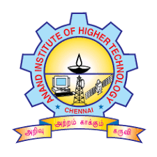

TOURISM MANAGEMENT SYSTEM
Presented By
HARINI SHREE.R (310120205019)
BRIGHTLIN ANGEL.S (310120205008)
Guided By
Ms. L. Steffina Morin, M.E.,
Anand Institute of Higher Technology
Kazhipattur,Chennai.

Slide 2
Domain of the Project
tourism management system typically encompasses various aspects of the tourism industry, including the management and coordination of tourism-related activities, services, and resources
This domain involves the management of tourist destinations, including information about attractions, accommodations, transportation, and local services. It focuses on organizing and promoting destinations to attract tourists.
This domain focuses on creating customized travel itineraries based on user preferences and available resources. It may include suggestions for activities, attractions, and routes, considering factors like travel duration, budget, and traveler interests.
CRM in the context of tourism management involves managing interactions and relationships with customers. It includes features such as customer data management, feedback collection, personalized recommendations, and loyalty programs.

Slide 3
Problem Definition
The tourism industry faces several challenges in effectively managing and coordinating tourism-related activities, services, and resources.
These challenges include the lack of centralized information, inefficient reservation and booking processes, inadequate itinerary planning tools, limited customer relationship management, manual tour operations, data fragmentation, ineffective marketing strategies, and cumbersome administrative and operational tasks.
There is a need for a comprehensive tourism management system that addresses these challenges and provides a unified platform for efficient management of various aspects of the tourism industry.

Slide 4
Objective of the project
Create a unified platform that consolidates information about tourist destinations, attractions, accommodations, transportation, and local services, providing a comprehensive resource for users.
Implement efficient reservation and booking functionalities that allow users to check availability, compare prices, and make secure and convenient reservations for accommodations, flights, transportation, tours, and other travel-related services.
Develop functionalities to automate the planning, execution, and monitoring of tours, including managing tour guides, transportation, logistics, and ensuring smooth operations.

Slide 5
Components/Tools Requirement
Hardware Requirements
RAM : 2 GB (minimum).
Storage : 1.5 GB (minimum).
CPU : 2 GHz or faster.
Architecture : 32-bit or 64-bit.
Software Requirements
Browser: Opera Mini, Google Chrome,microsoft edge.
Software: WAMP/XAMP/LAMP/MAMP is used to set localserver.
Operating System : windows 7 and above or Linux based OS or MAC OS.

Slide 6
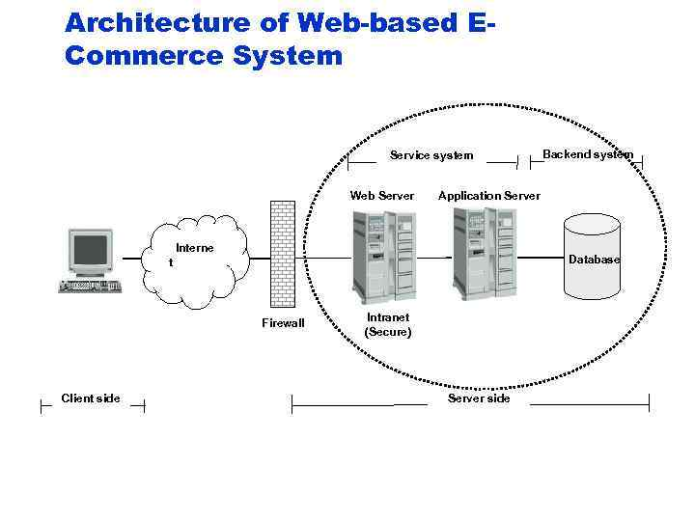
Proposed System & Architecture
PROPOSED SYSTEM:
Our proposed tourism management system aims to provide an integrated and comprehensive solution to efficiently manage various aspects of the tourism industry. The system will leverage advanced technologies to streamline operations, enhance customer experience, and improve overall efficiency for tourism businesses
ARCHITECTURE:

Slide 7
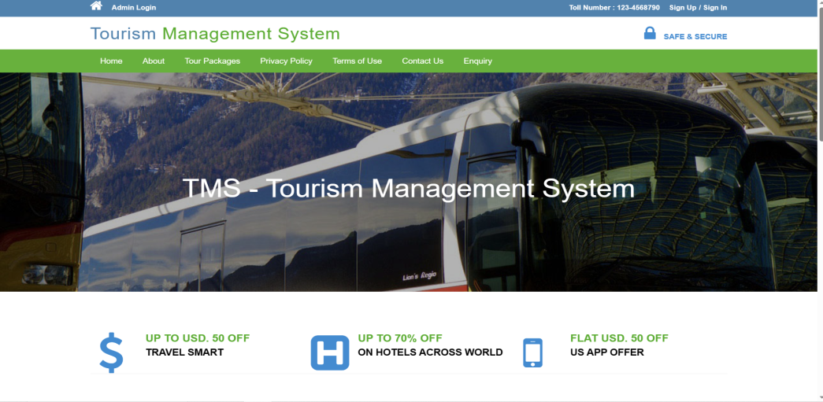
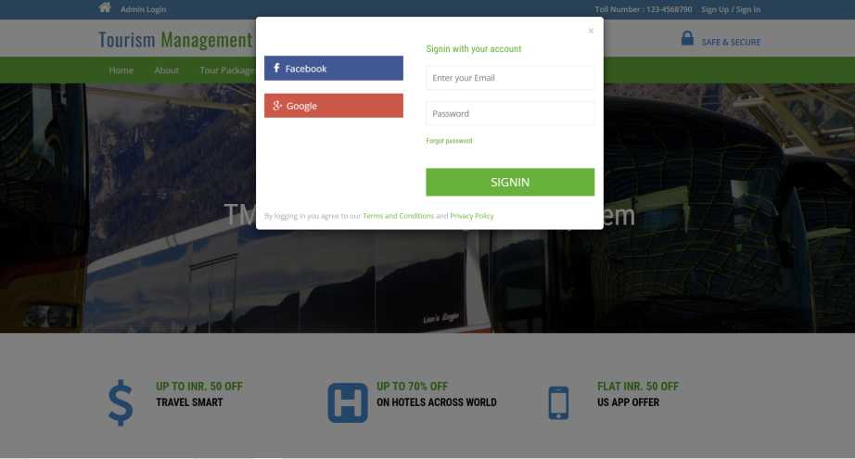
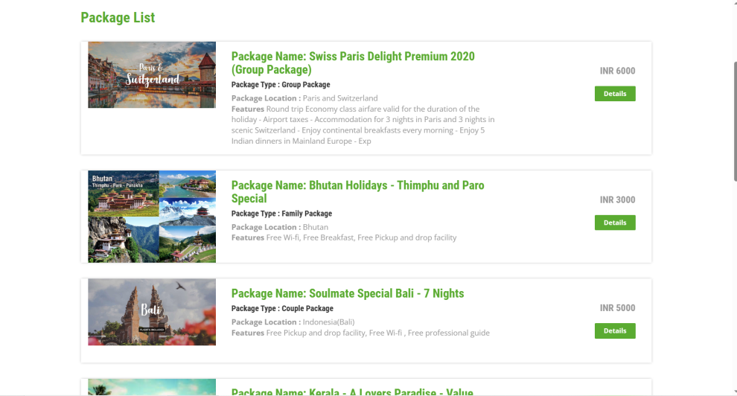
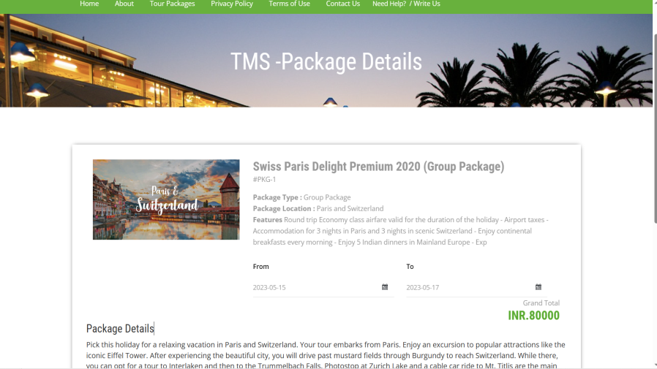
Output Slide (Screenshots)

Slide 8
Conclusion
This project is a comprehensive solution that addresses the challenges faced by the tourism industry in managing and coordinating various aspects of travel and tourism.
Through the implementation of the this system, stakeholders in the tourism industry can improve operational efficiency, enhance customer satisfaction, optimize resource utilization, and make data-driven decisions.
The system fosters seamless interactions between tourists, service providers, and destinations, leading to a more enjoyable and streamlined travel experience.

Slide 9
Thank you

